Slide 1
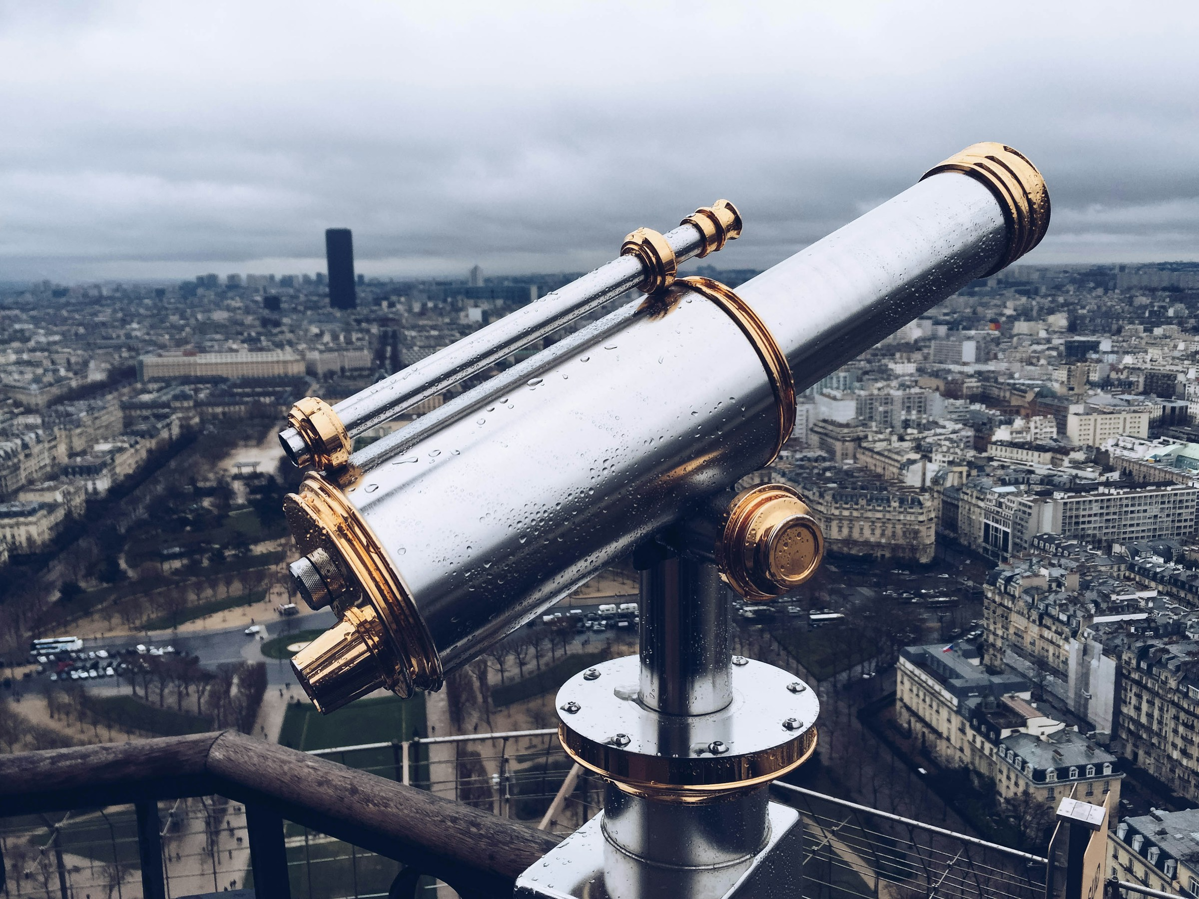
Distant Viewing Toolkit
Tutorial Slides 2
Taylor Arnold
Lauren Tilton
https://distantviewing.org

Slide 2

These slides are designed to accompany the Python tutorials that we have built to introduce the theoretical and methodological foundations of Distant Viewing alongside an overview of the tools made available through the Distant Viewing Toolkit. The slides contain additional notes, references, and diagrams that we find useful when using the tutorials during in-person workshops. Most of the technical notes and materials are available direction in the notebooks, which can be accessed at the following links:
https://colab.research.google.com/drive/1qQKQw8qHsTG7mK7Rz-z8nBfl98QBMWGf
https://colab.research.google.com/drive/1n7qWm47laCUJwg0-Rdx7pNw3dQWwuyxz
For further information about our work, please visit Distant Viewing Lab website at https://distantviewing.org or feel free to email us directly at tarnold2@richmond.edu and ltilton@richmond.edu.
Distant Viewing Tutorials | Overview

Slide 3
Tutorial 2
Network-Era Sitcoms and Visual Style
Distant Viewing Tutorials | Tutorial 2

Slide 4
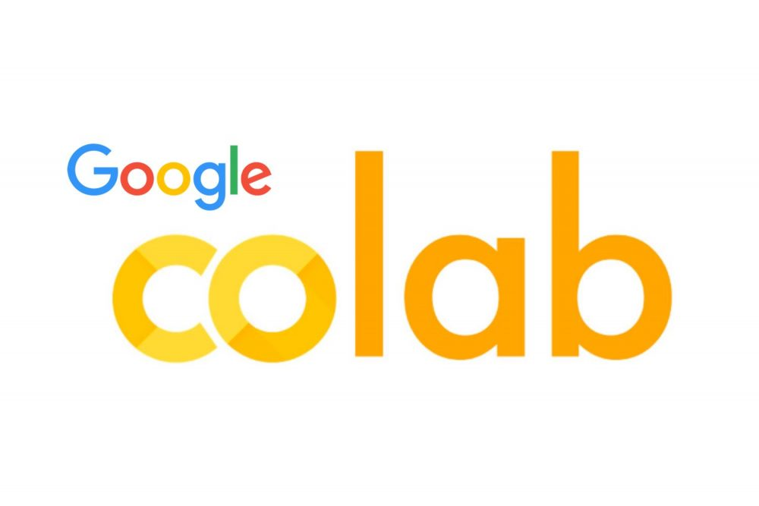
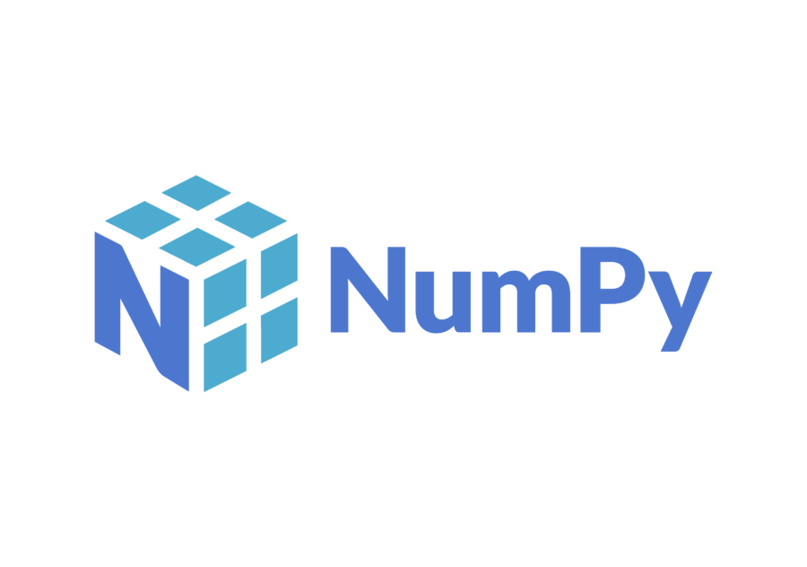
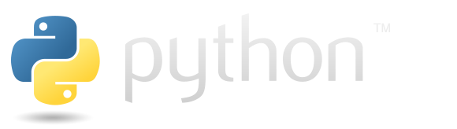
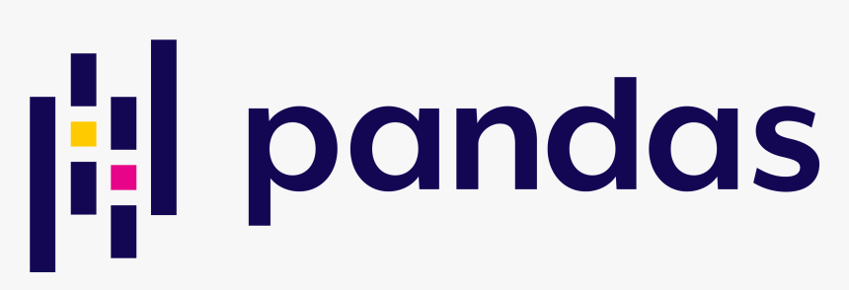
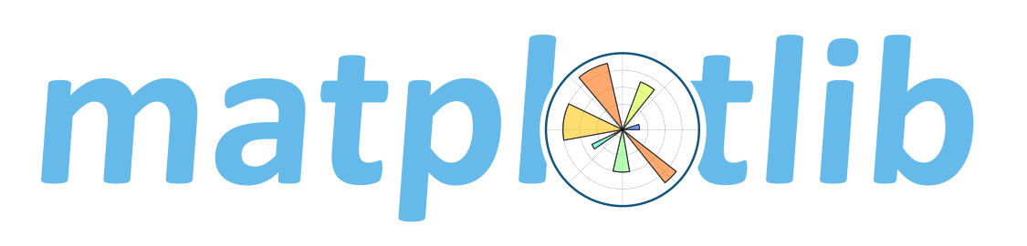
2.1 Setup
As with the first tutorial, the second tutorial makes use of Google’s Colab environment, which allows us to use the Python programming language directly from the browser without needing to install any software locally. Colab can be used for small projects for free, with paid plans available to access more computing resources.
NOTE: If you already followed the first tutorial, the setup code and slides are very similar. Feel free to skim/skip the associated text and slides. However, you do need to re-run all of the code because in Colab we start with a fresh session each time we open a notebook. Also, here we are downloading new datasets.
Distant Viewing Tutorials | 1.1 Setup

Slide 5
2.1 Setup
We will make use of three common Python modules for data analysis: NumPy, Pandas, and matplotlib.
All the software libraries used in the tutorial are available under open-source licenses. The code we work through can all be run on your local machine with just a little bit of extra setup required to get started.
Distant Viewing Tutorials | 1.1 Setup

Slide 6
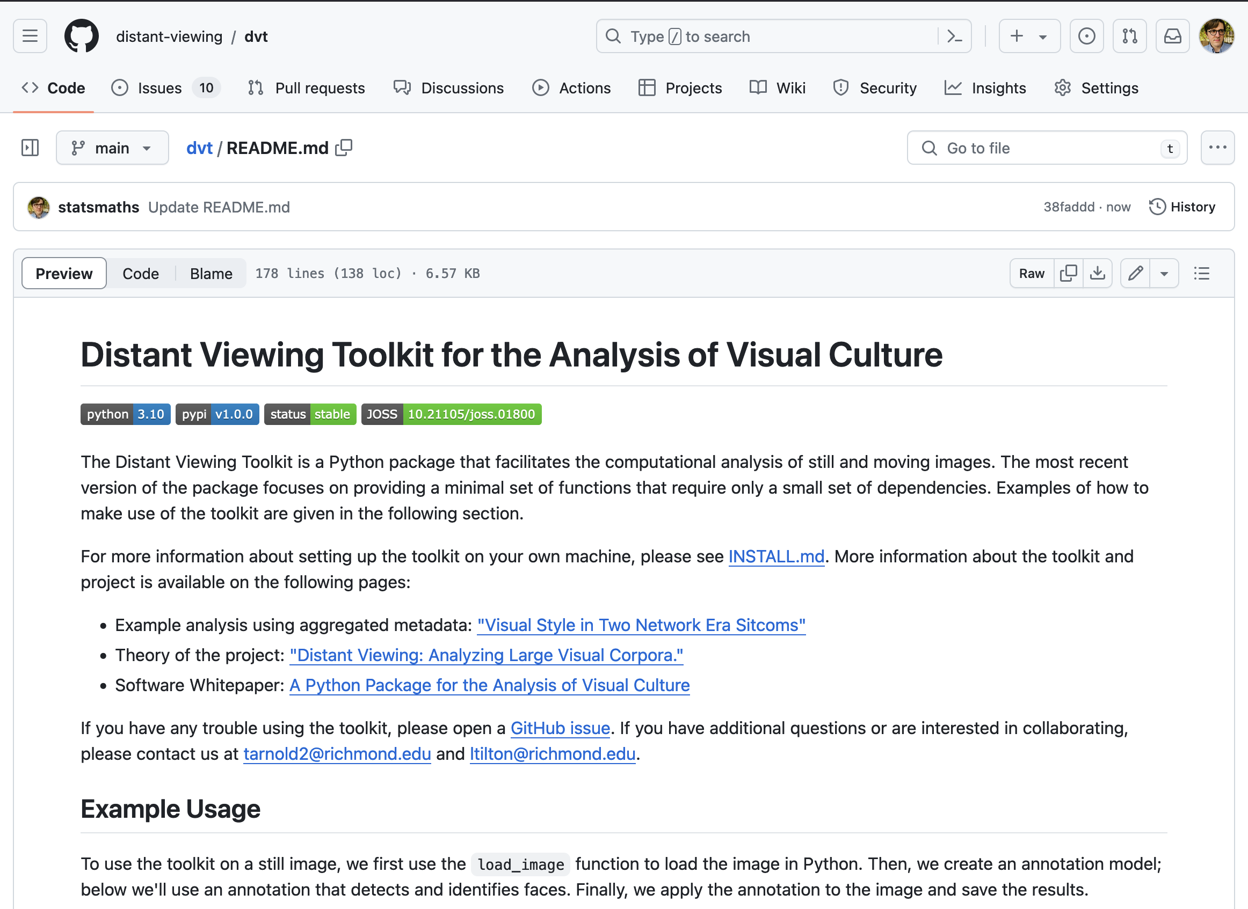
2.1 Setup
We will also be using a Python module that we built specifically for the humanistic analysis of visual materials: the distant viewing toolkit (dvt).
In this tutorial, we will use dvt to apply computer vision algorithm for face detection to digitized files containing moving images.
Distant Viewing Tutorials | 1.1 Setup

Slide 7
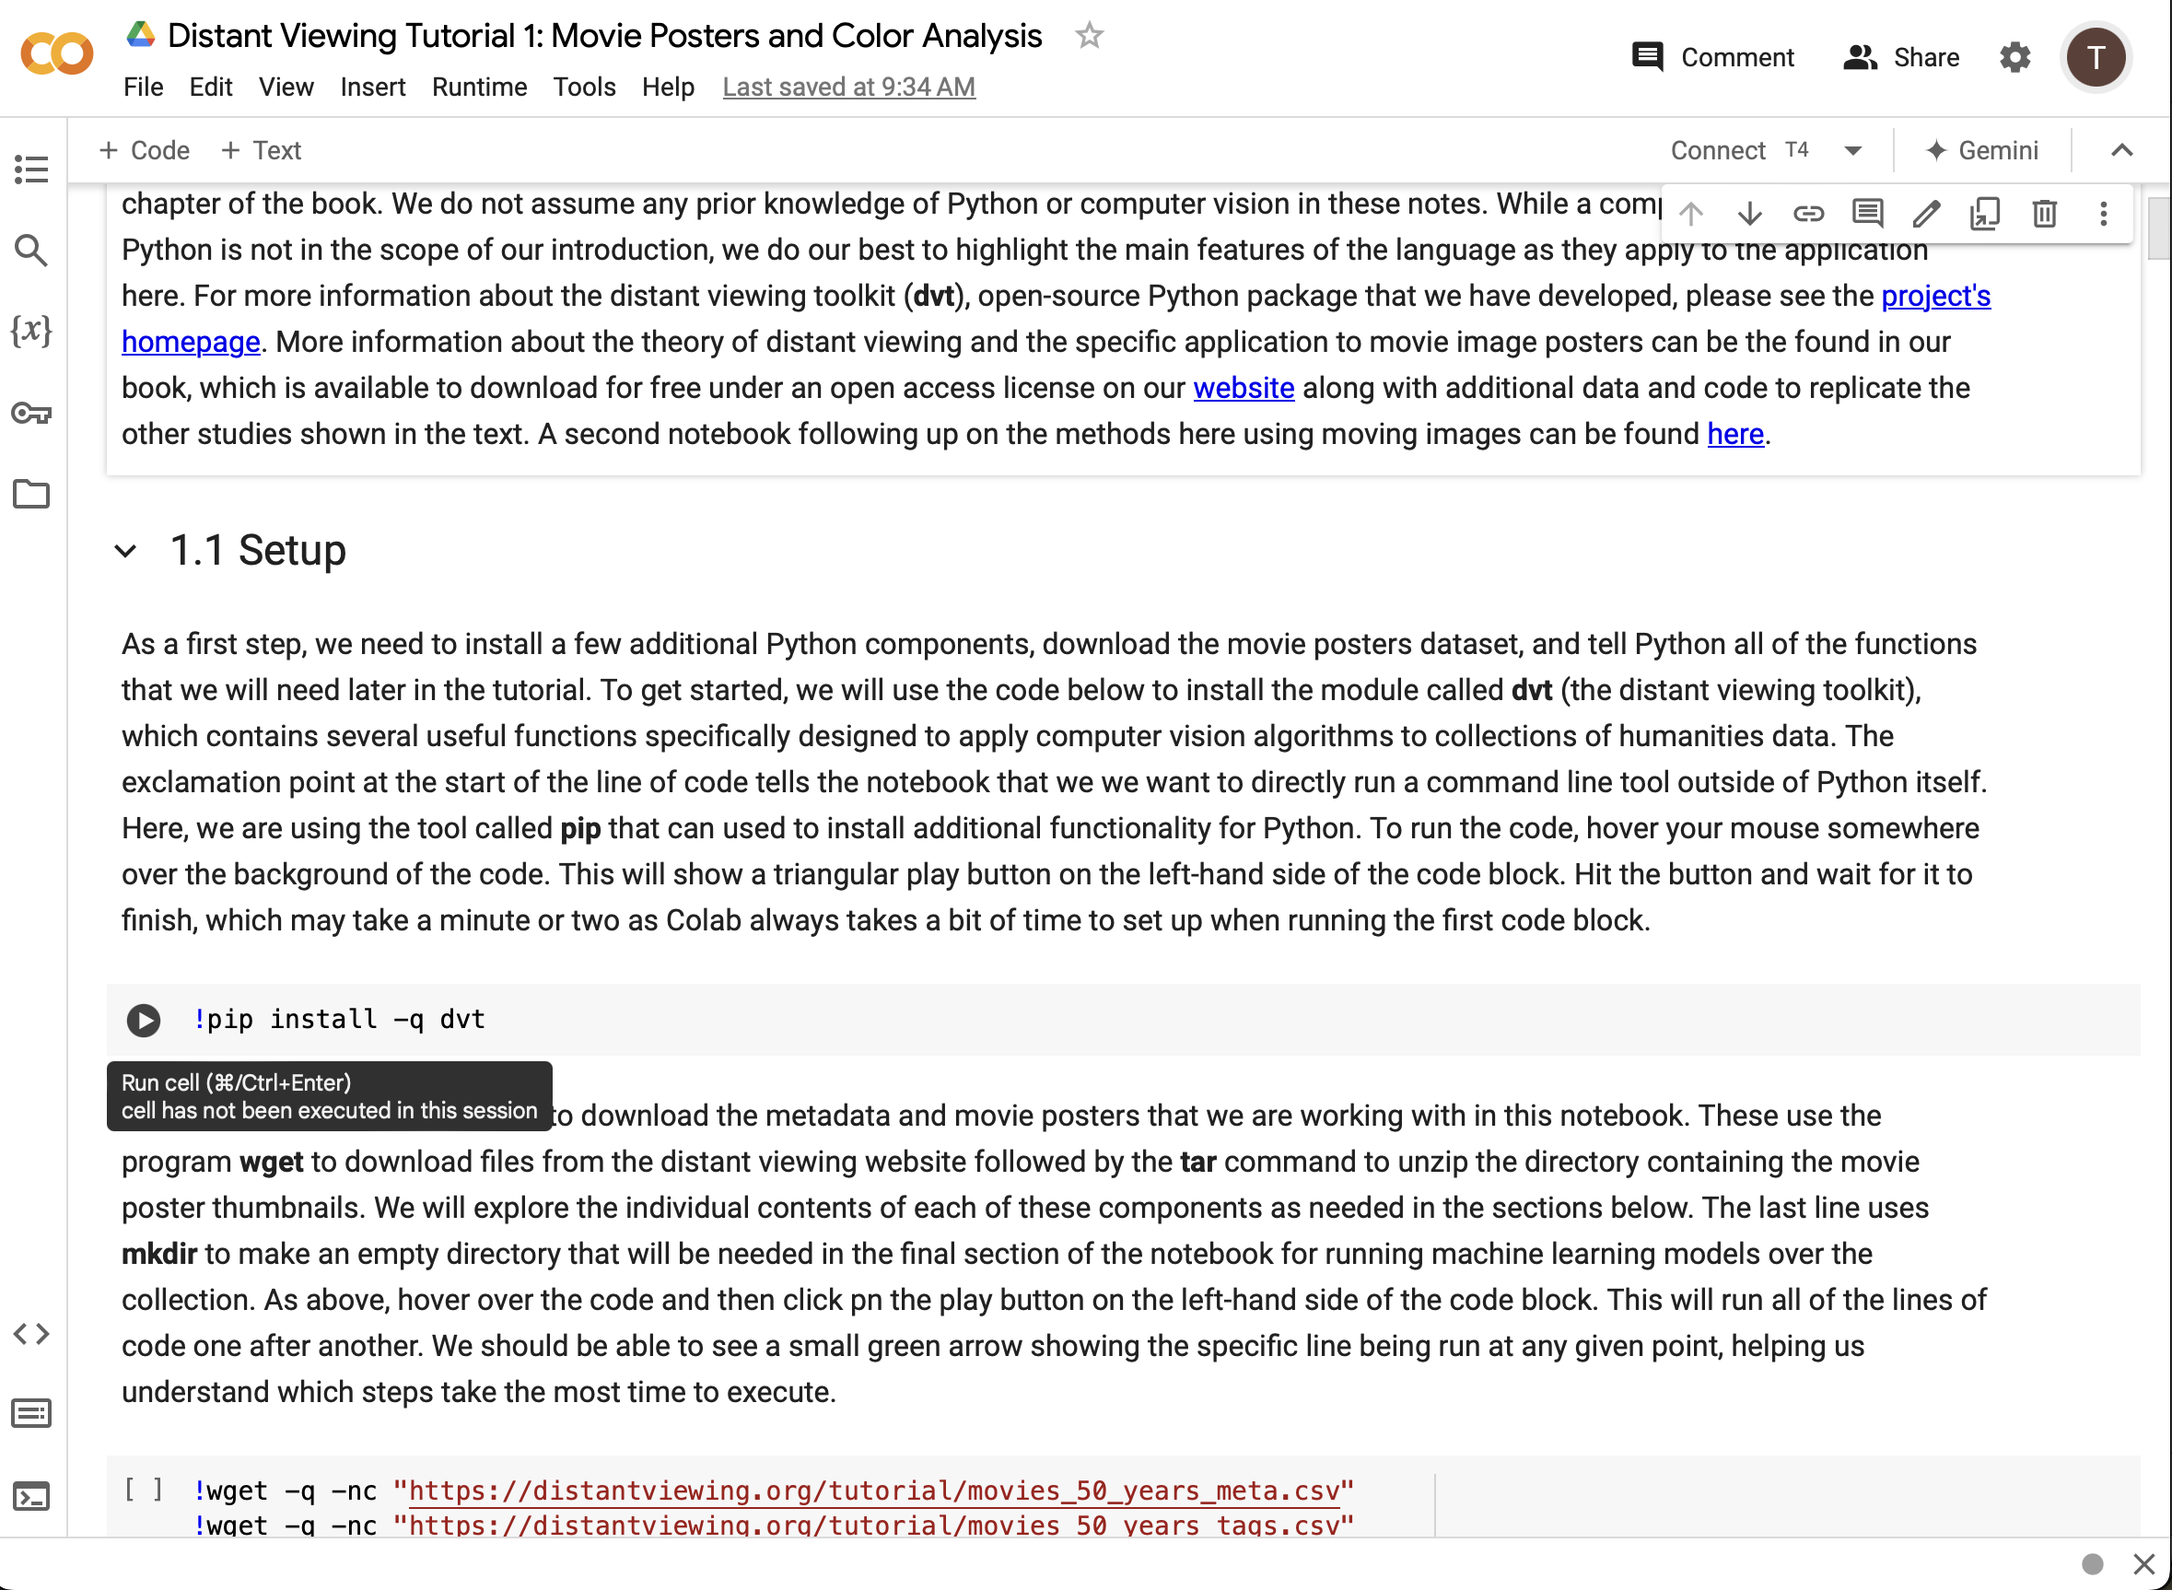
2.1 Setup
When opening the tutorial notebook in Colab, this should open a window in the browser similar to the one on the right-hand side here.
The notebook can be viewed by anyone; in order to run the code itself, we will need to sign into a Google account.
Note: You will be able to edit the code and text locally in your browser. These changes will not be saved for anyone else. So, at any point, feel free to play around with the code!
Distant Viewing Tutorials | 1.1 Setup

Slide 8
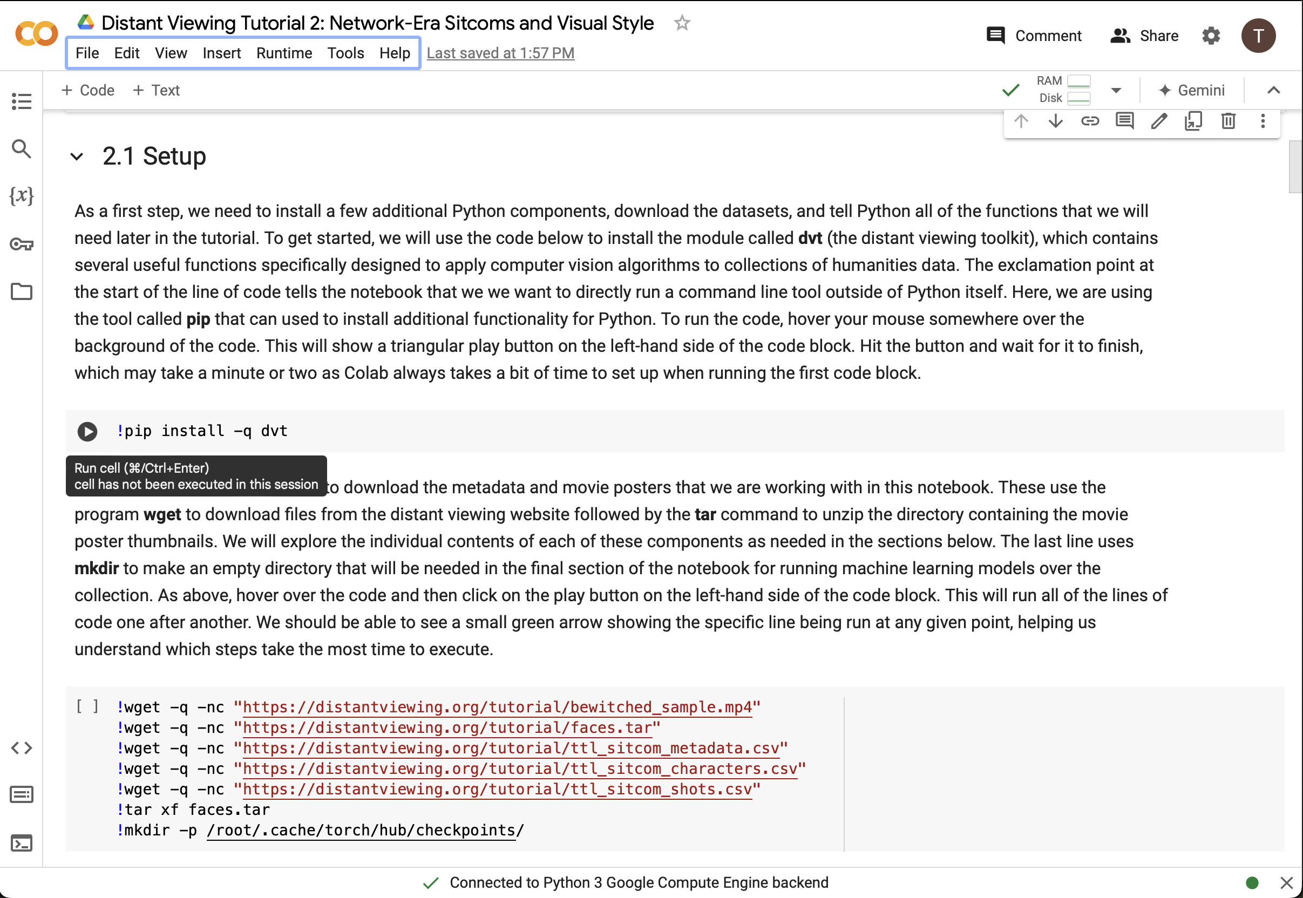
2.1 Setup
After signing into a Google account, we will be able to run the code block (the parts of the notebook on a grey background). To run the code, hover over the grey background and click on the play button as shown by the red arrow here.
Throughout the tutorial, we need to run each of the code blocks in order. You can go ahead now to read and run all of the setup code shown in the first section of the notebook.
Distant Viewing Tutorials | 2.1 Setup

Slide 9
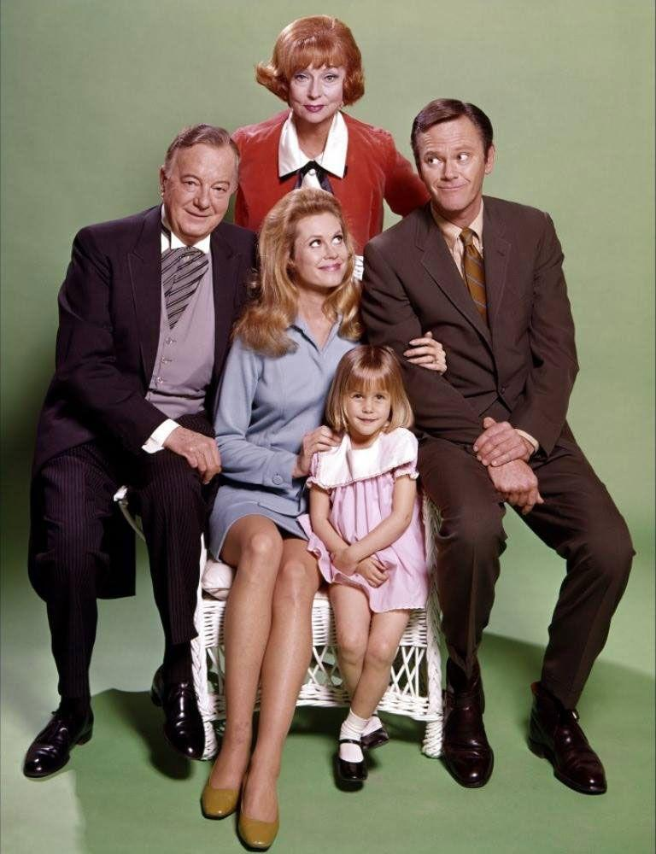
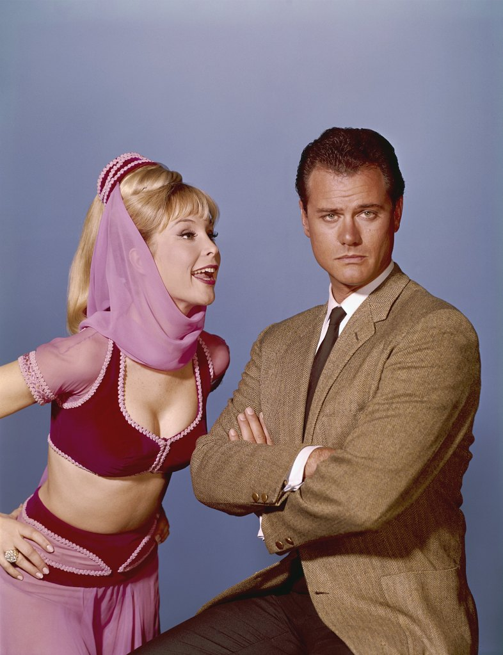
2.2 Network-Era Sitcom Dataset
Our analysis will study two popular U.S. sitcoms that ran from the mid-1960s into the early 1970s. A short summary of each reveals why they are often compared and contrasted with one another:
Bewitched: Central premise focuses on the marriage of the ordinary Darrin Stevens to the supernatural witch Samantha. Samantha does her best to live a “normal” American life, but difficulties from her magical world crop up to make this process challenging.
I Dream of Jeannie: Features a 2,000-year-old female genie, referred to as Jeannie, discovered by the astronaut Tony Nelson, whom she refers to as her “master.” A recurring plot device involves Tony attempting to fulfill his job responsibilities while hiding from and dealing with Jeannie’s magical antics.
Bewitched (ABC; 1964–1972)
I Dream of Jeannie (NBC; 1965–1970)
Distant Viewing Tutorials | 2.2 Network-Era Sitcom Dataset

Slide 10
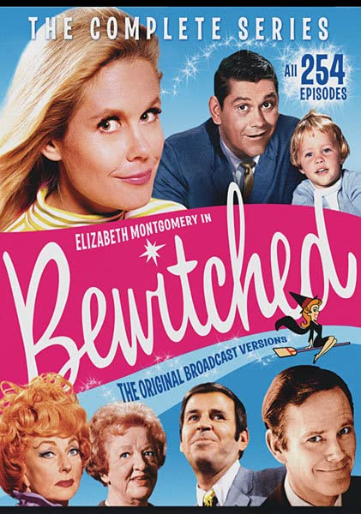
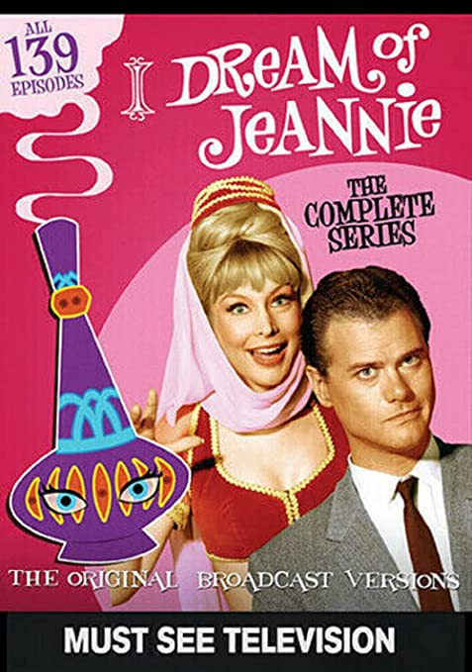
2.2 Network-Era Sitcom Dataset
In order to work computationally with these shows, we first purchased DVD sets that contained all 393 episodes from the two series. Then, we extracted the video files from the DVDs, a process now allowed in the U.S. through the DMCA §1201 of the U.S. copyright code.
The total collection contains over 150 hours of material consisting of over 13 million individual frames.
Dombrowski, Q., & Tilton, L. (2024). Access and Advocacy: Text & Data Mining and DMCA § 1201. Digital Studies/Le champ numérique, 13(3).
Distant Viewing Tutorials | 2.2 Network-Era Sitcom Dataset

Slide 11
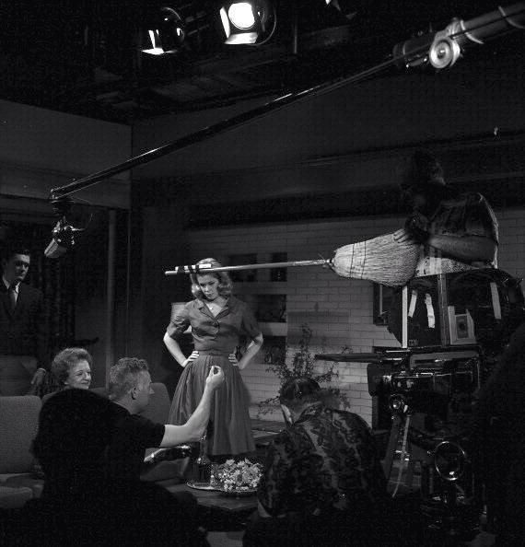
2.2 Network-Era Sitcom Dataset
Finally, before continuing on to the computation analysis, consider the following research questions that motivated our work on these shows:
How does the framing of a shot contribute to the pacing of the episode and how do these elements differ across series, time, and other features?
What and how do the visual and aural form of the television shows establish the centrality and role of each character?
What and how do the visual and aural form of the television shows establish relationships and intimacy between pairs of characters?
Consider your own hypotheses about these questions. Can you add any other similar questions that we could use this collection to address?
Filming on the set of Bewitched (1965).
Distant Viewing Tutorials | 2.2 Network-Era Sitcom Dataset

Slide 12
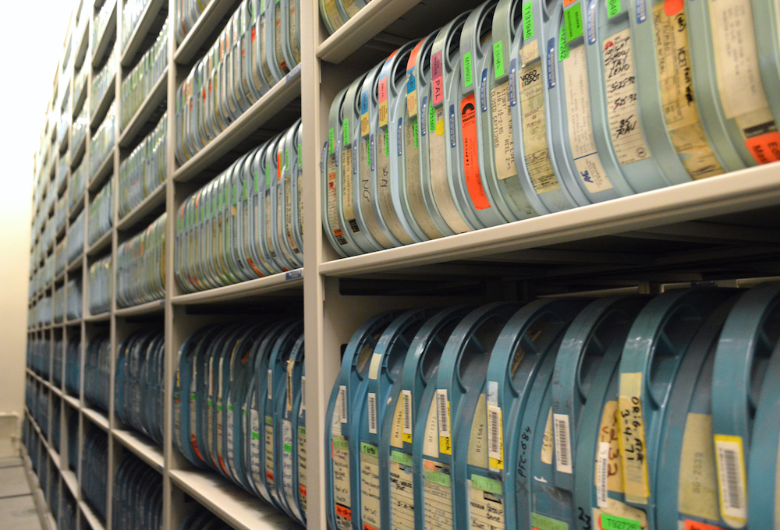
2.3 Sample Movie File
When doing computational analyses with visual and audiovisual materials, it is important to frequently go back and look at specific examples to ensure that we understand how our large-scale analysis connects back to the actual human experience of viewing.
Make sure to take some time watching the 45 second clip from Bewitched.
After watching the short clip, do you have any updated thoughts about our research questions? Are there any new research questions you might consider adding?
2-inch videoreels from UCLA Film & TV Archive
Distant Viewing Tutorials | 2.3 Sample Movie File

Slide 13
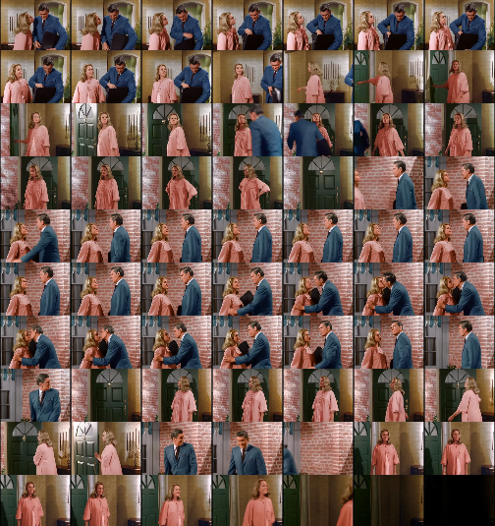
2.4 Working with Video Frames as Images
While video files are stored in highly compressed formats, often the best way to think of a digital video file is as a sequence of individual frames (along with a soundtrack), each made from an image of the same size.
As an example, the image on the right was made by taking every 10th frame from a forty-second clip at the start of the Bewitched episode “The Magic Cabin” (season 2, episode 16).
Distant Viewing Tutorials | 2.4 Working with Video Frames As Images

Slide 14
2.5 Shot Boundary Detection
As noted in the code, detecting the boundaries between shots is a frequent and important step in the computational analysis of moving images.
Looking at the sample frames on the right, can you identify where the shot breaks are? Notice that using brightness here as in the example in the notes would be challenging because at least one shot does not change the overall brightness much and the end of the sequence finishes with a fade-out.
Distant Viewing Tutorials | 2.5 Shot Boundary Detection

Slide 15
2.5 Shot Boundary Detection
Here are the detected shots from the algorithm included in the distant viewing toolkit. Do they correspond to the breaks that you found?
SHOT #1
SHOT #2
SHOT #3
SHOT #4
Li, Yanghao, et al. (2021) "Benchmarking Detection Transfer Learning with Vision Transformers." arXiv e-prints: arXiv-2111.
SHOT #5
SHOT #6
Distant Viewing Tutorials | 2.5 Shot Boundary Detection

Slide 16
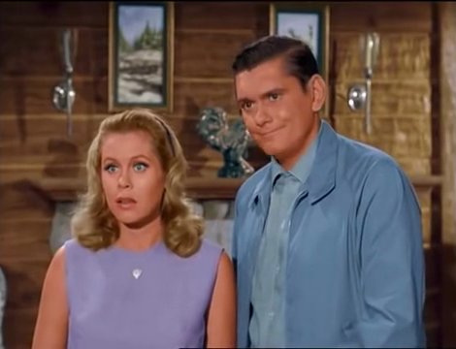
2.6 Face Detection and Facial Recognition
As you may have also seen in the first tutorial, detecting the location of faces in an image is often a useful annotation for many applications.
For moving images, noting the location of the character’s faces can often serve as a starting point for understanding the editing and blocking of shots. These are exactly the kinds of relationships that align with our research questions.
Distant Viewing Tutorials | 2.6 Face Detection and Facial Recognition

Slide 17
2.6 Face Detection and Facial Recognition
Using the algorithm contained in the distant viewing toolkit, here are the two faces detected in this shot from Bewitched.
Zhang, K., et al. (2016). "Joint face detection and alignment using multitask cascaded convolutional networks." IEEE Signal Processing Letters, 23(10):1499–1503.
Distant Viewing Tutorials | 2.6 Face Detection and Facial Recognition

Slide 18
2.6 Face Detection and Facial Recognition
As described in the Python notebook, when working with film and television data we often also want to identify which character is associated with each of the faces in a frame.
Using the same technique shown in the example in the notebook, here are the estimated character names and similarity scores for the two characters.
Darrin (.63)
Samantha (.72)
Cao, Qiong, et al. (2018). "VGGface2: A dataset for recognising faces across pose and age." 13th IEEE international conference on automatic face & gesture recognition.
Distant Viewing Tutorials | 2.6 Face Detection and Facial Recognition

Slide 19
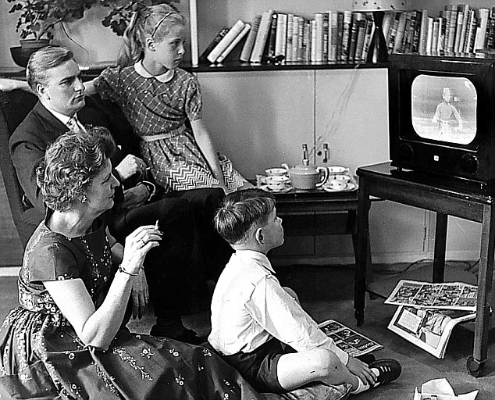
2.7 Building Annotations from a Video File
Once we understand how to run the annotations over a short clip of the corpus, the next step is to run the algorithms over the entire collection. When working with large sets of moving images this can take a significant number of computational resources and/or time, so we have cached the results for the notebook to read in directly.
One step that we are skipping here is the method for selecting the thresholds and breakpoints when filtering the data. For example: At exactly what probability do we determine that a face is really found by the algorithm? How close does a face need to be to a portrait to consider having found a character? If we run the algorithm over many frames from a shot, how do we aggregate them? Answering these requires a lot of going back to the original materials and manually figuring out what thresholds work best for our application.
Distant Viewing Tutorials | 2.7 Building Annotations from a Video File

Slide 20
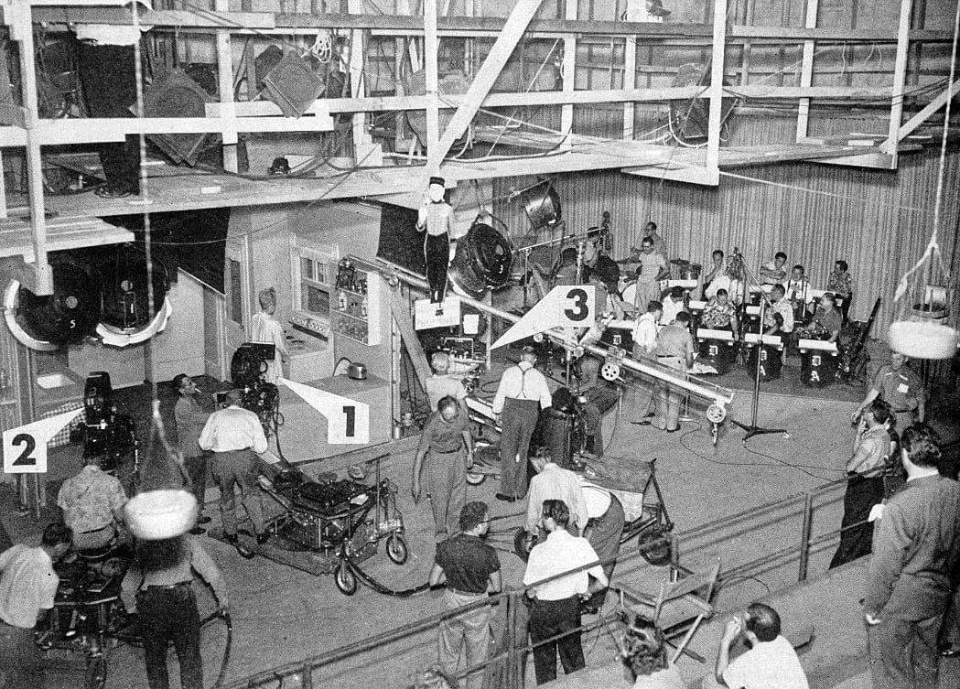
2.8 Full Corpus Analysis
In this section of the notebook, we see how to use the extracted data to address some of the research questions we previously posed.
Note that only a small set of the analyses contained in the book chapter are presented here. We encourage interested readers to check out the longer analyses featured in the book.
Can you think of ways to extend this analysis using newer techniques (LLMs?) or by including additional television shows into the corpus?
Stage 2 of General Service Studio, where I Love Lucy TV was produced, showing the three-camera setup used on stage. American Cinematographer.
Distant Viewing Tutorials | 2.8 Full Corpus Analysis

Slide 21
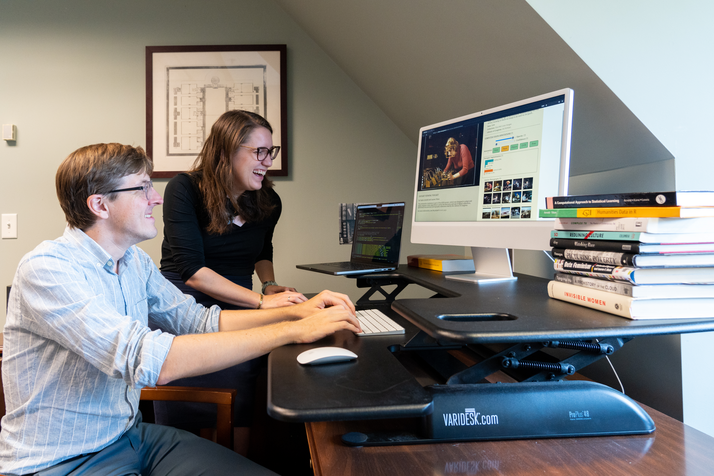
2.9 Conclusions and Next Steps
There are many directions to explore after following the second tutorial:
To see how to complete the analysis in the second tutorial here, check out Chapter 5 of the Distant Viewing.
If you are new to programming, see the links in the notebook to learn a bit more about working with Python.
For those who skipped the first tutorial, it may be useful to now go back to it in order to gain a deeper understanding of how digital images work and the implications for the theoretical underpinning of distant viewing.
Thank you for taking time to engage with us. Please reach out with any questions or feedback!
https://distantviewing.org
tarnold2@richmond.edu
ltilton@richmond.edu
Distant Viewing Tutorials | 2.9 Conclusions and Next Steps

